Slide 1




Minimum Wages and Employment: A Case Study of the Fast-Food Industry in New Jersey and Pennsylvania: Reply
DAVID CARD AND ALAN B. KRUEGE (2000)
Sophie Hensgen, Tiffany Myers, Khizer Naushad, Yusang Zhang

Slide 2
Introduction
Card and Krueger’s case study focuses on the effect of minimum wage increase on employment in the fast food industry during 1992
before and after the wage increase
Location: New Jersey (NJ) and eastern Pennsylvania (PA)
April 1, 1992, NJ raised their minimum wage from $4.25 to $5.05 per hour
NJ had the highest minimum wage in the country
No clear theory applied, instead tested against predictions of Economic Theory - a rise in wages leads competitive employers to let go of their employees
Several studies with similar methodology tested this theory and results failed to show negative employment effect on higher minimum wages

Slide 3
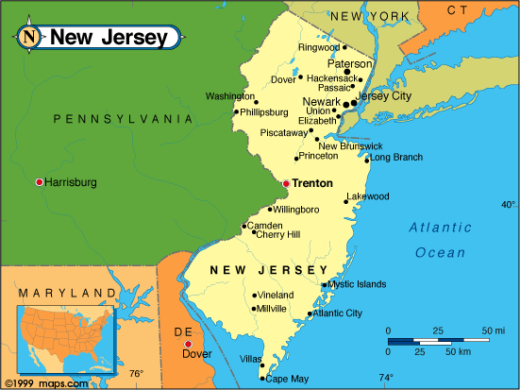
Sample Design
Sample size - 410 restaurants
Restaurants surveyed- Burger King, KFC, Wendys, and Roy Rogers
Control group - fast food restaurants in PA
proximity and similarity to NJ
Time frame - 2 Waves in 1992
Wave 1 - before the rise in minimum wage
February to March 1992
Wave 2 - 7 to 8 months after the rise in minimum wage
November to December 1992

Slide 4
Simple use of empirical methodology
Card and Krueger’s first wave of the study was conducted by telephone interviews
Surveys consisted of questions regarding employment, starting wages, meal prices, and other characteristics of the chain restaurants
Several significant features to data set:
- Recession*
- Due to NJ size, using PA as a control group
- Successfully followed nearly 100% of stores in conducting interviews for the first wave (before the minimum wage increased) and the second wave (7-8 months after the increase)
Wage variation in NJ before the wage increase allowed Card and Krueger to compare high wage and low wage chain restaurants within NJ
Employees in different parts of NJ earned $5.00 an hour (above average)
*Card and Krueger state that legislation was passed 2 years before recession occured, although highly unlikely that the effects of the higher minimum wage were obscured by a rising tide of general economic conditions

Slide 5
Wave 2 consisted of a second round of interviews to the same 410 restaurants
Out of 410 respondents in first wave, only 371 responded in second wave (90%)
39 non respondents - store closure, temporary store closure, and renovations
Card and Krueger’s study additionally tested other factors such as:
Whether the minimum wage increase affected employment in restaurants that already had above average wages before the law was passed
If minimum wage differed between full time and part time employees
Management offset the increased wages by reducing fringe benefits.
Restaurants increased the meal prices to offset the wages

Slide 6
Main Findings
Card and Krueger find no indication of a rise in minimum wage reduces employment
Full time employment increased in NJ after the law was passed
Full time and part time had equivalent starting wages
No statistically significant evidence that managers offset the increased wages by reducing fringe benefits - NJ saw a shift towards more generous fringe benefits since the wage increase but this is not statistically significant
Found that meal prices in NJ rose 3.2% faster than in PA between the February and November 1992
provides mixed results if higher wages lead to higher meal prices
Appears that when the minimum wage increased, the consumers took the burden of offsetting the costs
Increased wages led to increased employment in NJ

Slide 7
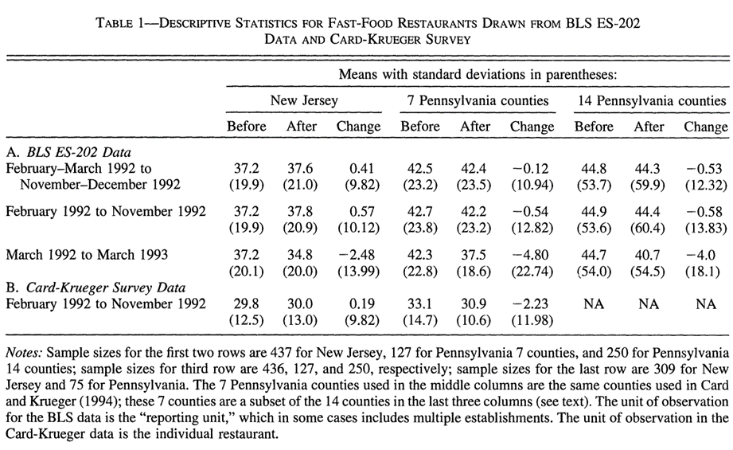
Methodology overview
(1) NW: Inappropriate telephone interview dataset
CK: New dataset – Bureau of Labor Statistics’ employer-reported ES-202 data file (BLS ES-202)
Correlations are the same, there are little differences in the coefficients.
(2) NW: Excessive variance of CK data may cause bias of employment change.
CK: According to BLS ES-202 data, the variance is larger than the original data.

Slide 8
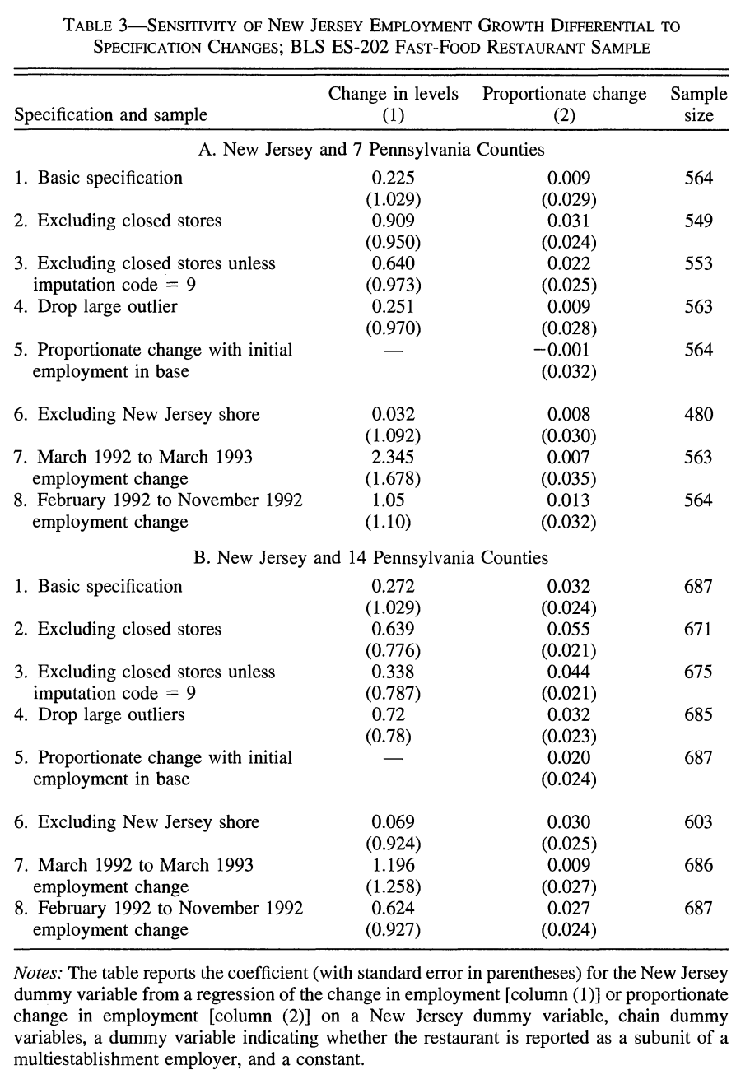
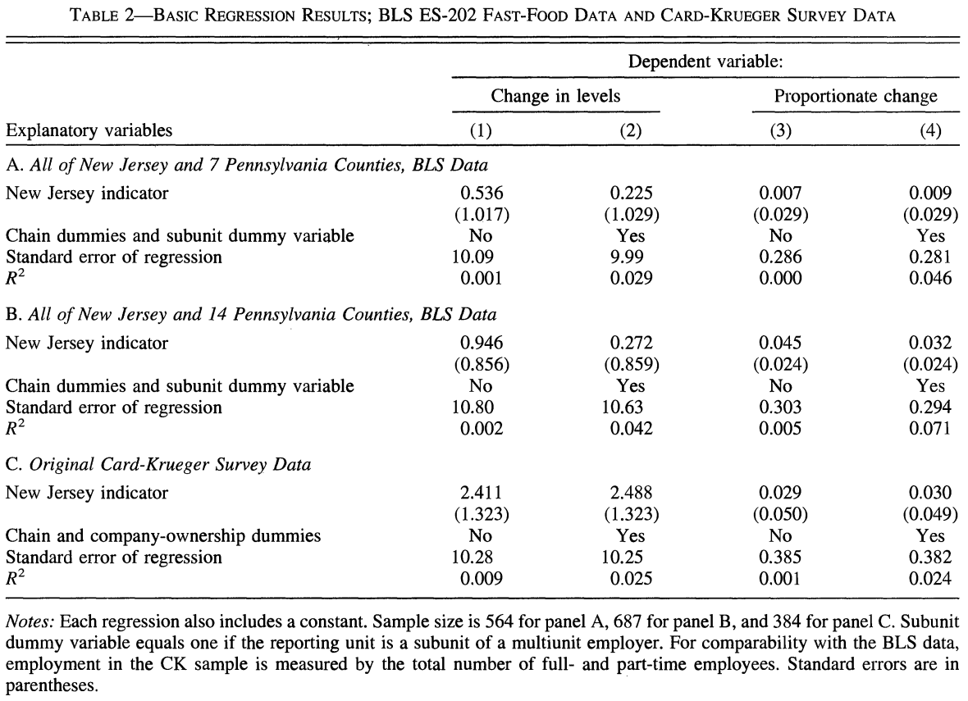
Expand 7 countries sample in Pennsylvania based on BLS ES-202.
Closed stores
outliners
Positive Effects
Significant

Slide 9
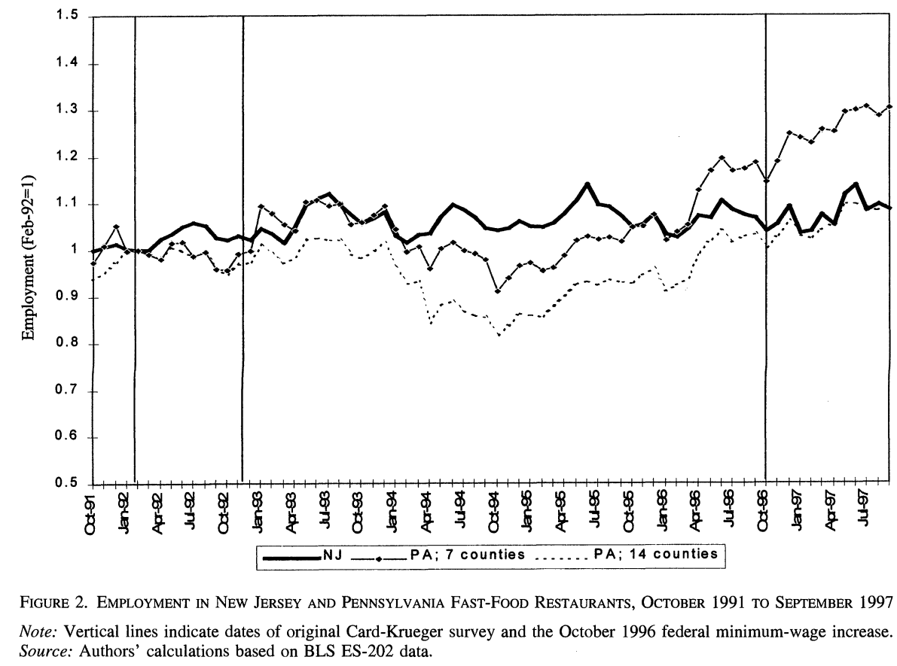
Pennsylvania: $4.25 🡪 $4.75, NJ: Remain $5.05
10%
2%
(3) NW: Minimum wage Employment.
CK: Minimum wage Employment..
-
+

Slide 10
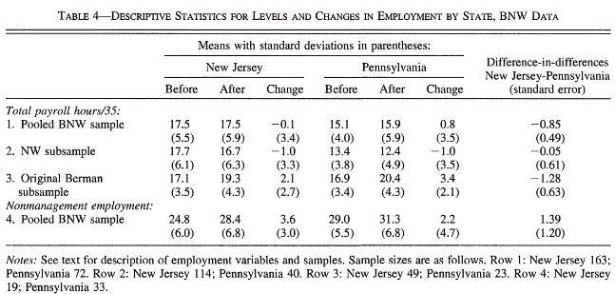
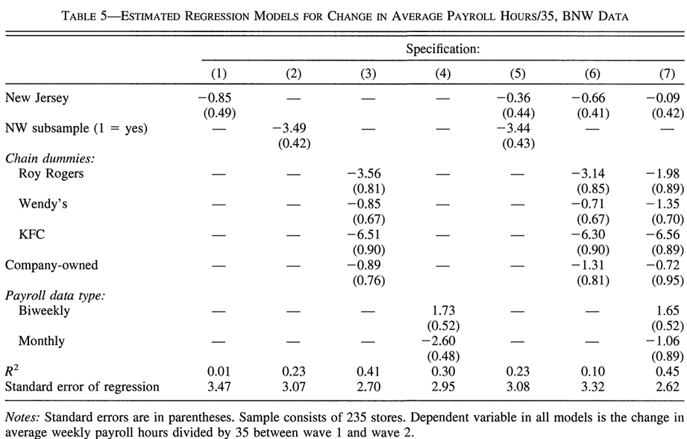
Reanalysis of NW’s data – BNW data:
Problems of BNW data:
A scientific sampling method was not used – 50% of restaurants in original BNW sample supplied non management employment data, only 10% was reported in NW subsample.
Data was collected three years after minimum wage increase.
Simple comparison of relative employment growth in Table 4 makes no allowances for other sources of variation in employment, effects of controlling for some of alternative factors are illustrated in Table 5.

Slide 11
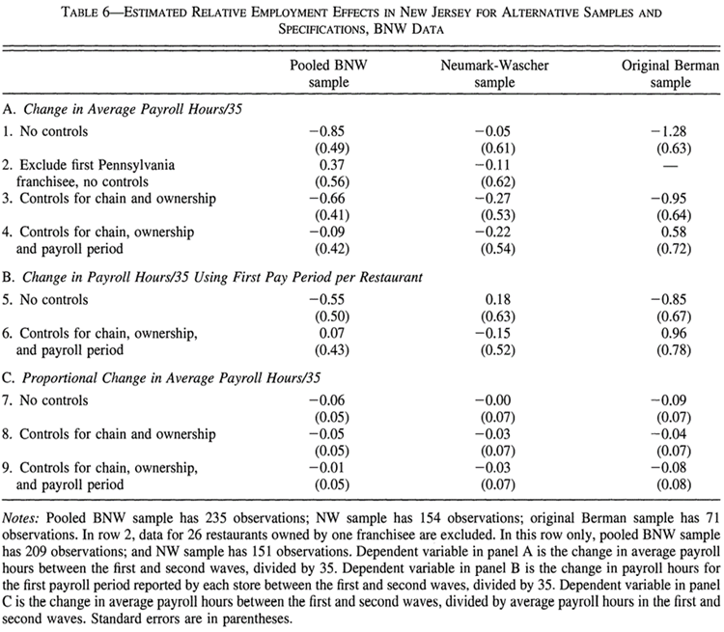
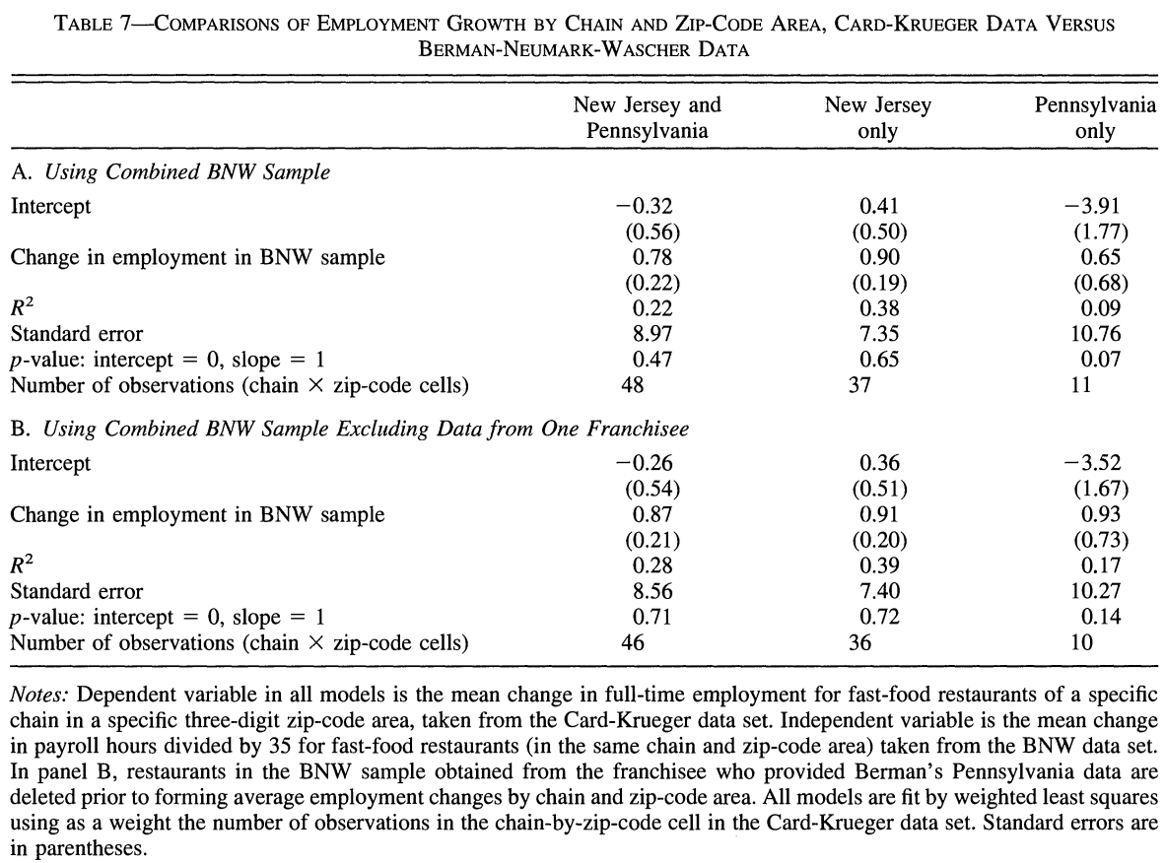
The estimated coefficient on the New Jersey dummy from a variety of alternative models fit to the samples.
The consistency of the two data sets, particularly in Pennsylvania was improved.

Slide 12
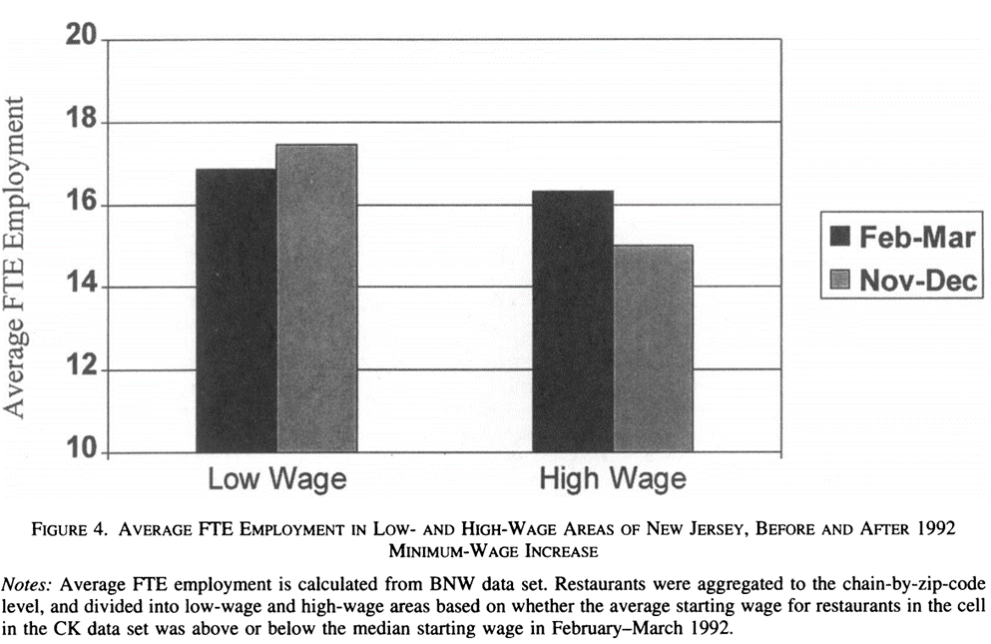
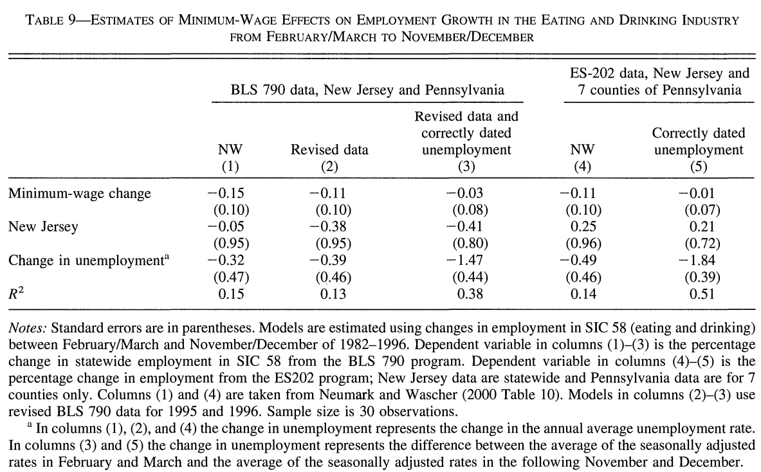
Revised data and correctly dated unemployment (3) is consistent with the estimates of ES-202 data.
Patterns of employment changes within NJ.
Reject the negative impacts of the minimum wage on employment.
The increase in New Jersey's minimum wage probably had no effect on total employment in New Jersey's fast-food industry, and possibly had a small positive effect.

Slide 13
Questions for NW’s data:
The differential employment trend in the BNW Pennsylvania sample is driven by data for restaurants from a single Burger King franchise.
The employment trends measured in the BNW sample are significantly different for restaurants that reported their payroll data on a weekly, biweekly, or monthly basis.
Reflect on DID Methodology:
The results of DID in investigating policies influences could be complex since the final results could be a combination of multiple positive and negative effects.
2. The final results could be totally different when using different data source.
3. We should control other factors that may cause bias strictly when collecting data.

Slide 14
Replication (S & K)

